Slide 1
LAPTOP SHOP USING SPRINGBOOT
Team Members
Vivek Khobragade - EBEON0722629139
Vishal Lokhande - EBEON0722634455
Vamsi Doma - EBEON0722633124
Mohammed Ali Pasha – EBEON0722114452
Jerome David – EBEON0722632534
Guided by
Varadharajan A

Slide 2
LAPTOP SHOP (MODULE)
Laptop Details
Different Categories Of Laptops

Slide 3
LAPTOP DETAILS
Categories of Laptops
This Module presents different categories of laptops

Slide 4
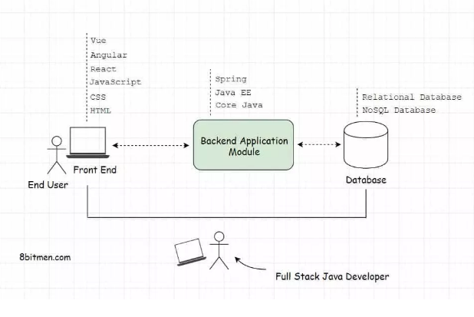
FULL STACK DEVELOPING

Slide 5
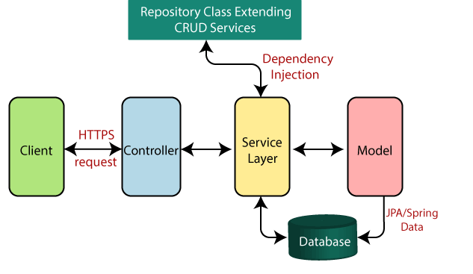
SPRING BOOT FLOW ARCHITECTURE

Slide 6
Dependencies:
➢ spring-boot-starter-security
➢ spring-boot-starter-Thymeleaf
➢ spring-boot-starter-web
➢ spring-boot-Devtools
➢ Mysql-connector-java
➢ spring-boot-starter-data-jpa

Slide 7
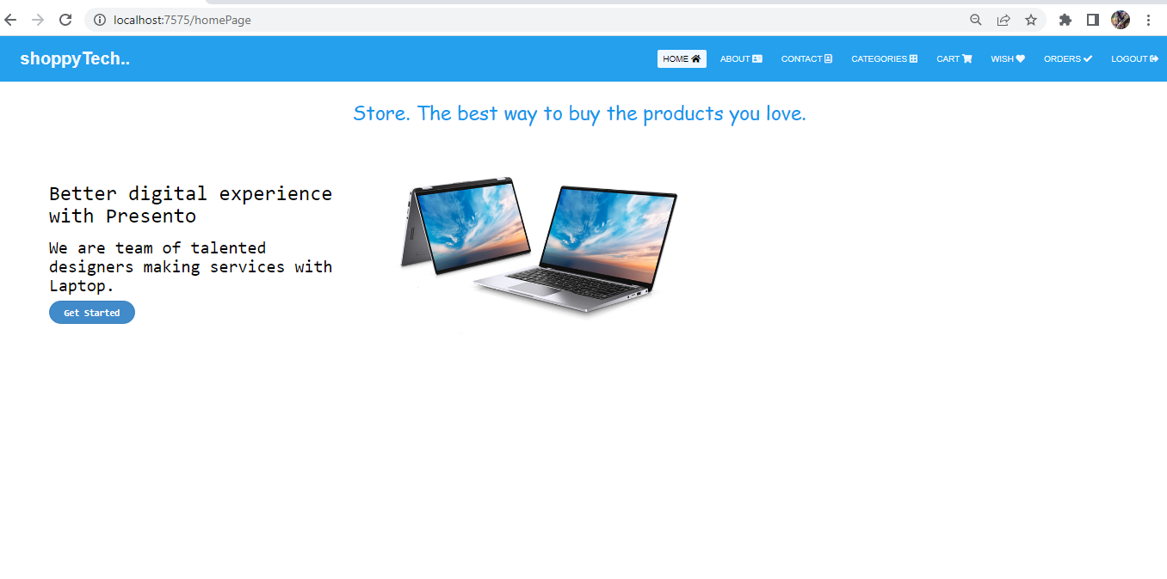
HOME PAGE

Slide 8
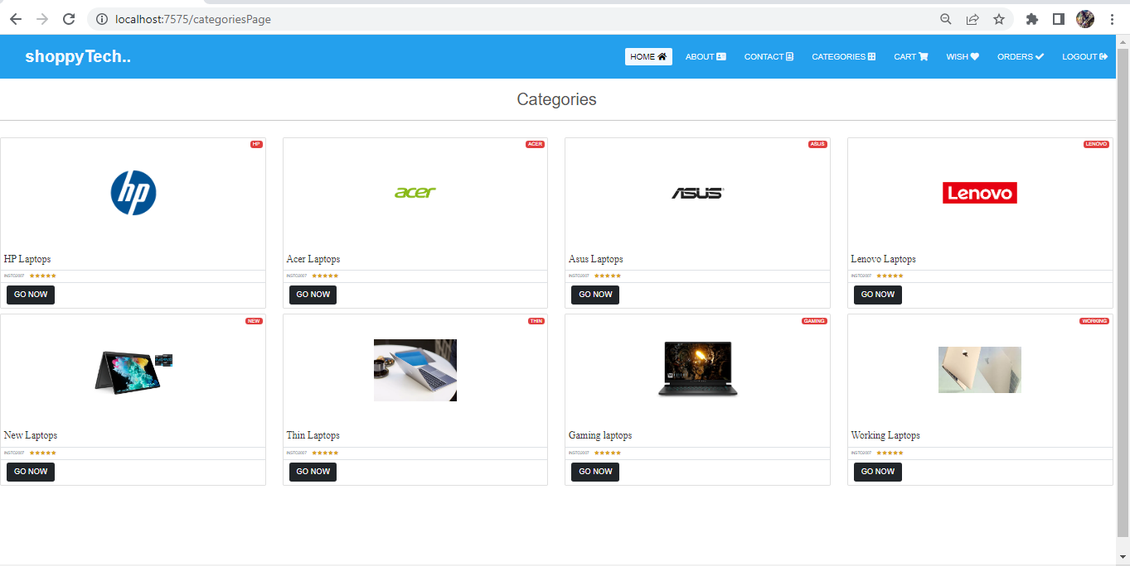
CATEGORIES PAGE

Slide 9
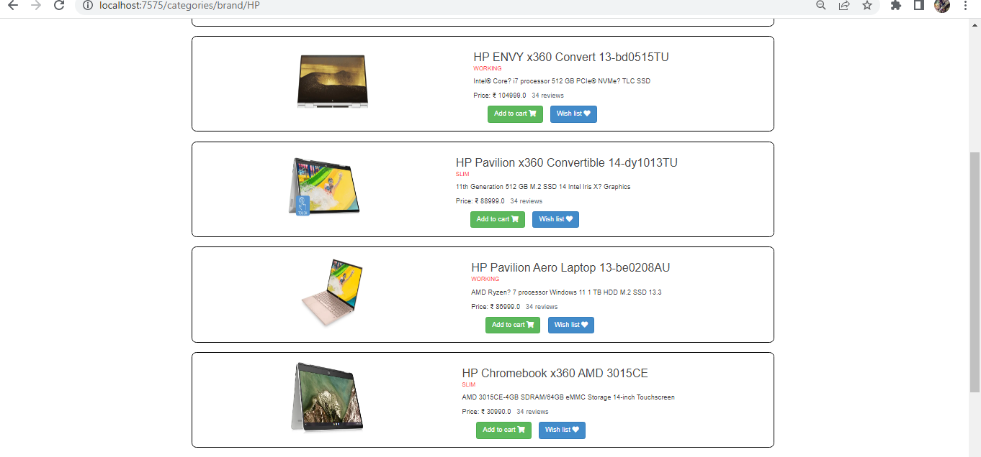
HP LAPTOP

Slide 10
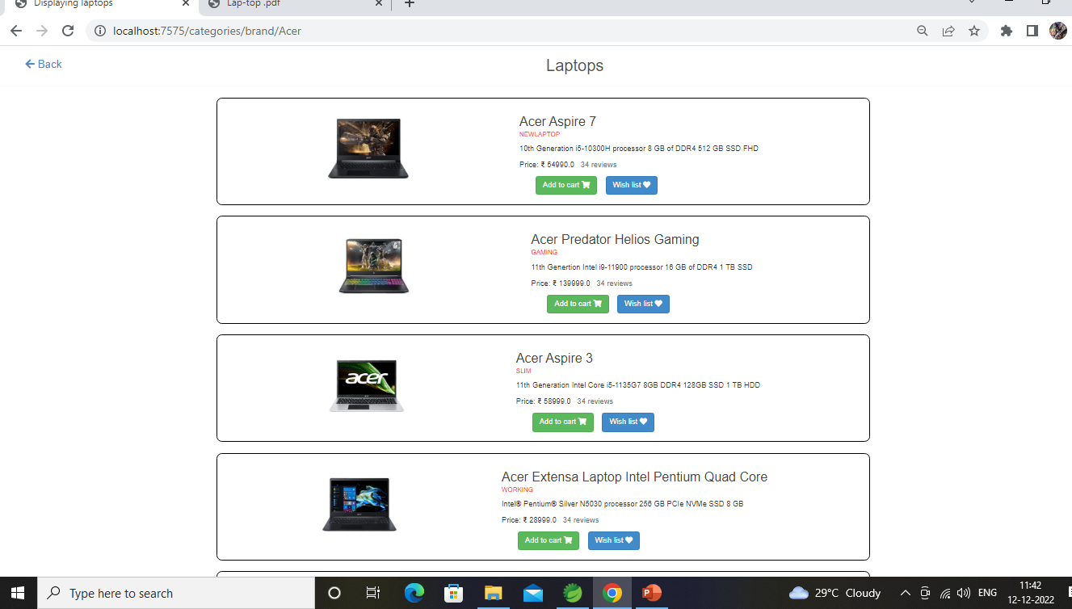
ACER LAPTOP

Slide 11
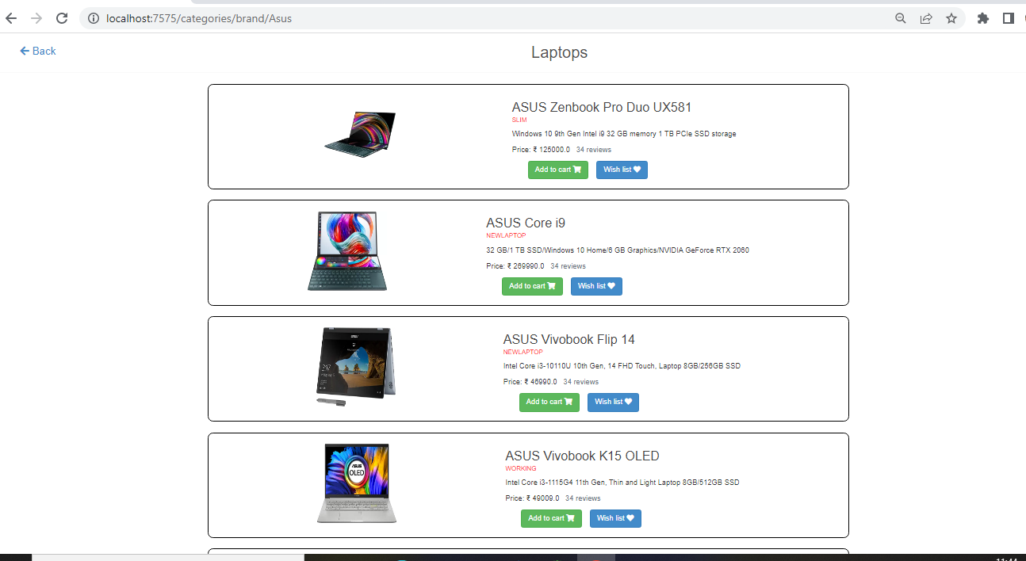
ASUS LAPT0P

Slide 12
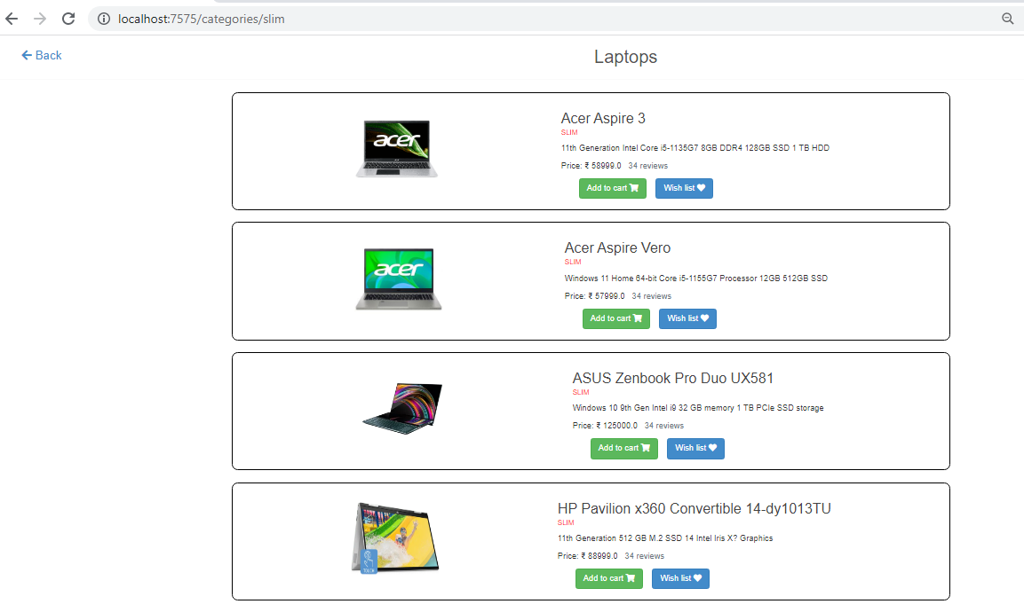
THIN LAPTOP

Slide 13
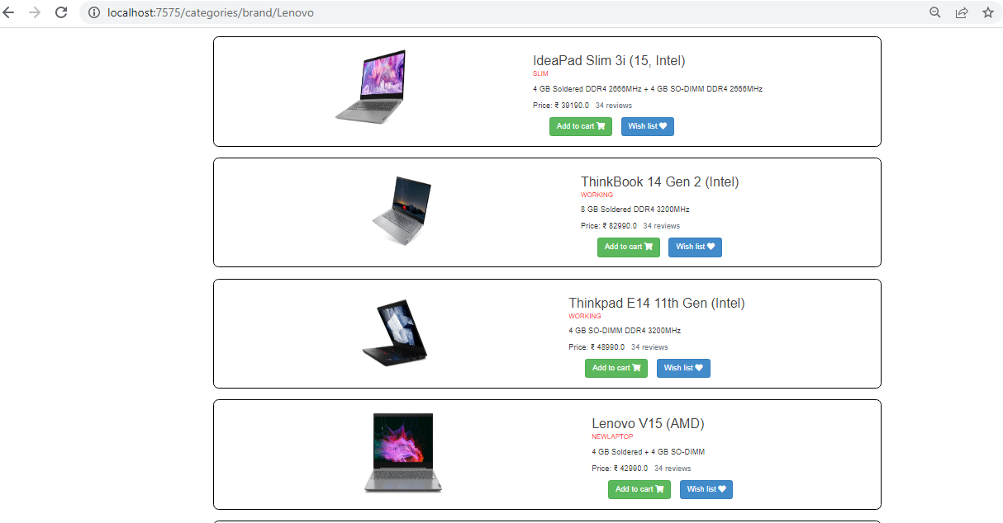
LENOVO LAPTOP

Slide 14
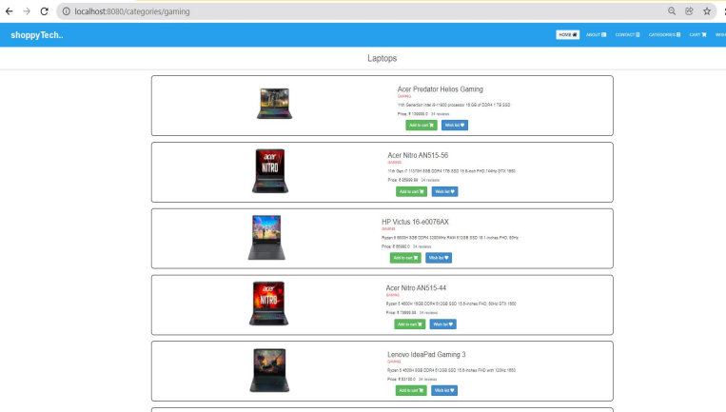
GAMING LAPTOP

Slide 15

Challenging issues
,
Changing Server port=7575
Enabling Debugging

Slide 16
Features about the module
Extensive Product Information
User friendly design

Slide 17
Conclusion
Laptop shop project explains about the E-commerce Shopping, This project mainly explains the various actions related to online shopping. Like displaying laptop products depends on brands, styles then add the favourites to wishlist for buying those products add them in cart select the product which you want to buy and remove the product which you don’t want to buy.

Slide 18


